Slide 1
Capstone Project-1
Play Store App Review Analysis
Group 4
Rishabh Rohil
Saniya Bubere
Ashi Saxena
Rahul Jadhav

Slide 2

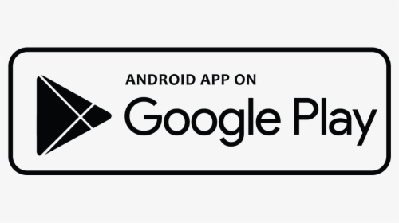
Why did We choose the google play store for analysis?
Google Play services helps to ensure the security and reliability of an Android device, and keep devices updated with the latest security features.
Google Play partners with developers to provide access to over 2 billion active monthly users and it offer nearly
2 Million app. Distribution is free for everyone but because of this developers may receive feedback from tester and get certain amounts of reviews. We use this and got some knowledge about the app to predict its success
Mobile App Market is set to grow 20% by 2023
Android Apps comprise 90% of the Mobile App Market

Slide 3



Overview of Exploratory Analysis
Explore the Data : While Exploring the data we determine a useful way to understand what datasets are representing
Data Cleaning: In Datasets there is so much Null values Because of that the prediction was not correct So We clean all the unwanted data from both datasets
Query Analysis: In this We tried to make a visualization based on problems

Slide 4
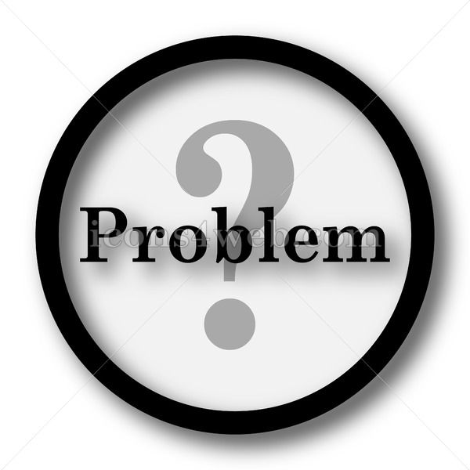


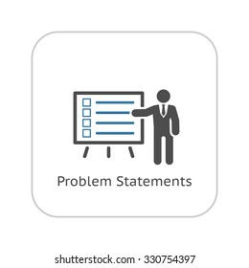

Problem Statement
Two datasets are provided, one with basic information of Play Store App and Second one is of users reviews
Every row contains various entries regarding a certain app. We will be doing Exploratory data analysis on this data set, which is a very important step in data science cycle, as it not only helps in taking very initial business decisions .Our objective will be to structure the data, clean it and present certain trends that we observe that can help us draw very preliminary conclusions about the probability of success of a newly launched app. Also our objective is to Explore and analyze the data to discover key factors responsible for app engagement and success
We have to make a valuable insights from both the datasets in order to identify the important characteristics

Slide 5
Agenda:
Introduction
Sentiments of Free App
Sentiments of Paid App
Sentiments & Reviews
Correlation between Columns
box plots for size and rating
Percent of Free VS Paid App in Store
Number of Apps And its Category based on Type
Counts Based on Rating
Top 5 App Based on Category
Top 5 Category in terms of Installs
Ratings
Counts Based on Size
Average installs in term of Size
Count based on Android Version
Counts based on Last Updates
Updates with Years
Top 5 Revenue Categories

Slide 6
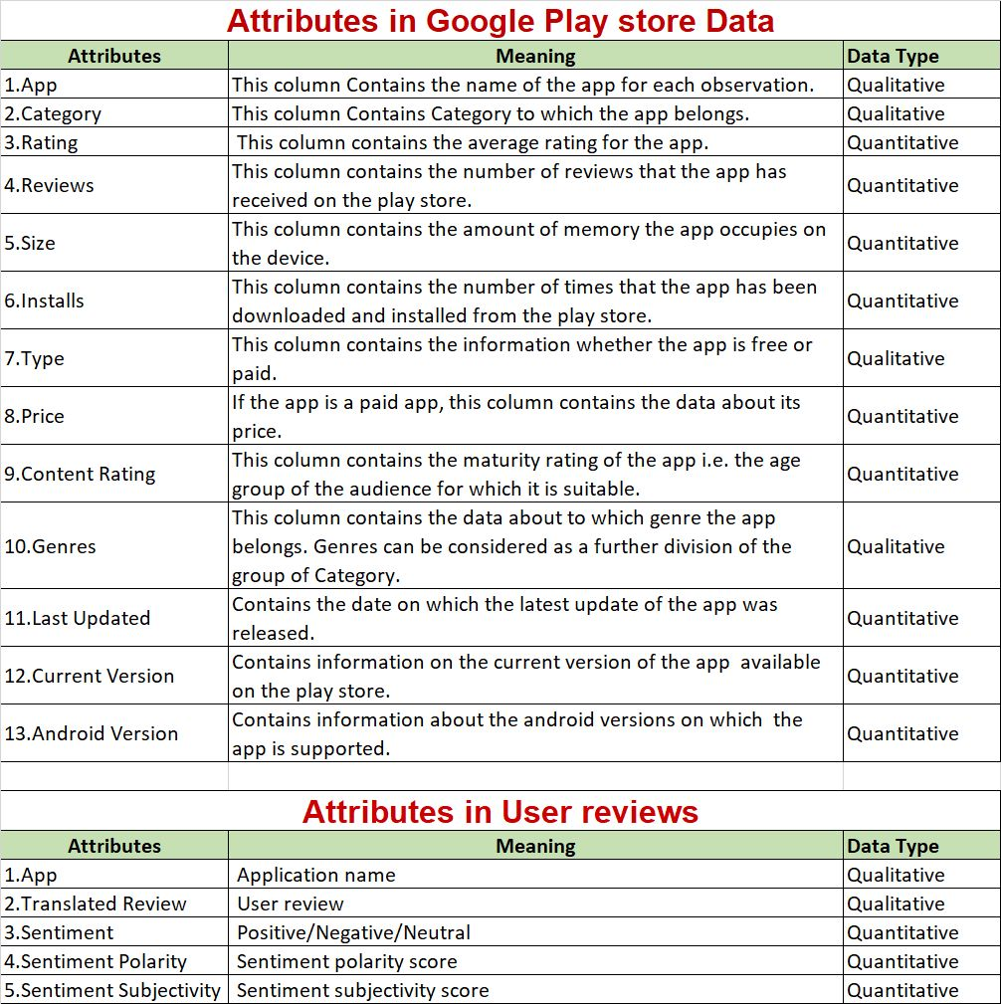

Slide 8
Dataset Construction
Mounting the drive : Because of Mounting we can access csv file to do analysis
Loading Datasets : Two datasets is there in project First is store app and Second is User Reviews
Import Libraries: Compulsory to use Libraries like Numpy , Pandas , Matplotlib and Seaborn .
When your using Google colab then this necessary to use %matplotlib inline where plot graphics will appear in your notebook
Data Cleaning: Removing Outliers , Finding and Removing Null values
Data Assings: Replacing the Null Values with Mean ,Median & Mode with its suitable Condition.
Query Analysis: Analayzing the data sets to points of interest using visualization.

Slide 9
Explore the Arrangement of Datasets
Play store dataset.csv: shape(10841,13)
This file contain this features that is:
App: Name of Apps.
Category:Category of Apps (ART_AND_DESIGN,FINANCE,COMIC,COMMUNICATION,GAME etc)
Rating:Rating on app and it is between 0 to 5
Reviews:Total Users given reviews on every app
Size:Size is in Megabytes(MB)
Installs:Number of times the app was downloaded from google play
Type:Type is Paid or Free
Price:Price is in $
Content Rating:Which Age Group have Rated the App

Slide 10
Explore the Arrangement of User Reviews Datasets
User reviews dataset.csv: shape(64295,5)
This file contain 5 features that is:
App: Its contain Apps Name.
Translated Review: It contain reviews
Sentiments: It contain Positive ,Negative, Neutral Sentiments.
Sentiment Subjectivity:It contain Numeric values between negative to positive 1.
Sentiment Polarity: defines the orientation of the expressed sentiment

Slide 11
Exploratory Data Analysis

Slide 12
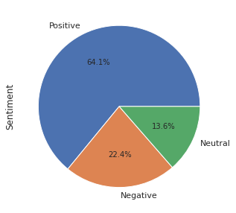
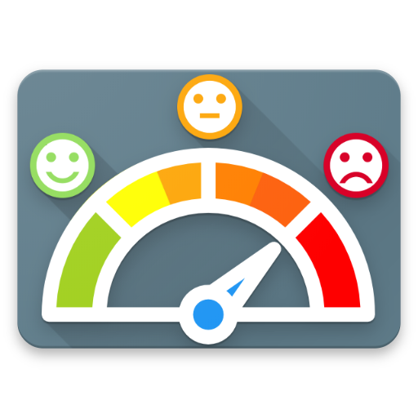
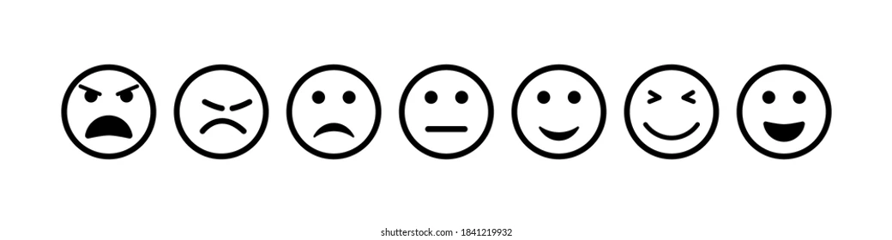
Sentiments of Free App
In the free apps 64.1 % apps has positive sentiment followed by 22.4 % and 13.6 % for Negative and Neutral sentiment respectively

Slide 13
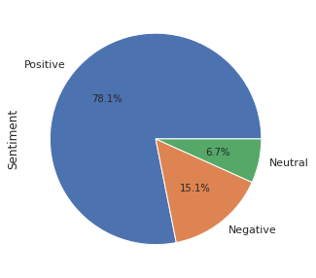
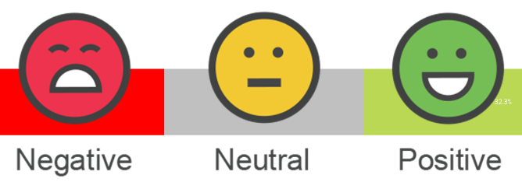

Sentiments of Paid App
In the paid apps 78.1 % apps has positive sentiment followed by 15.1 % and 6.7 % for Negative and Neutral sentiment respectively

Slide 14
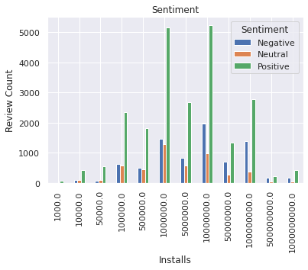


Sentiments And Reviews
From the Sentiment , review graph we can see that no of installs 1000000 and 10000000 has highest review with positive sentiments

Slide 15
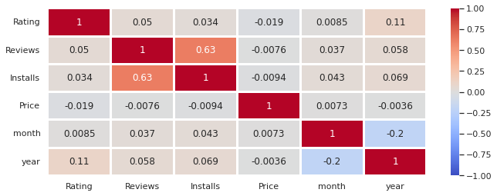
The correlation between different columns.
From this correlation matrix, we see that reviews and installs are positively correlated. Also, if an app has higher number of installations then obviously it will have more reviews. One more thing to notice is that correlation of price with every column is less than 0.

Slide 16
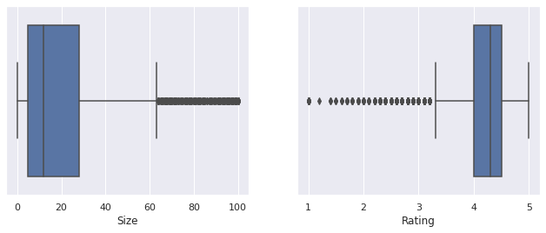
Box Plot to identify Outliers
Maximum app have size between 0 to 30 , rest all are Outliers & Maximum Rating is between 4 to 4.5 rest all are outliers

Slide 17

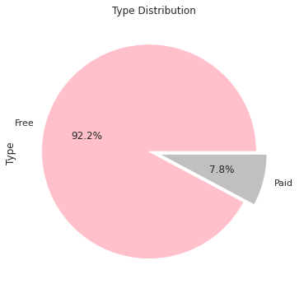


Percent of Free Vs Paid Apps in play store
From this insight we can see play store have 92.2% Free Type and 7.8% is paid type

Slide 18
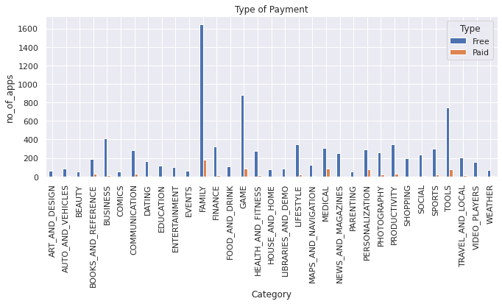
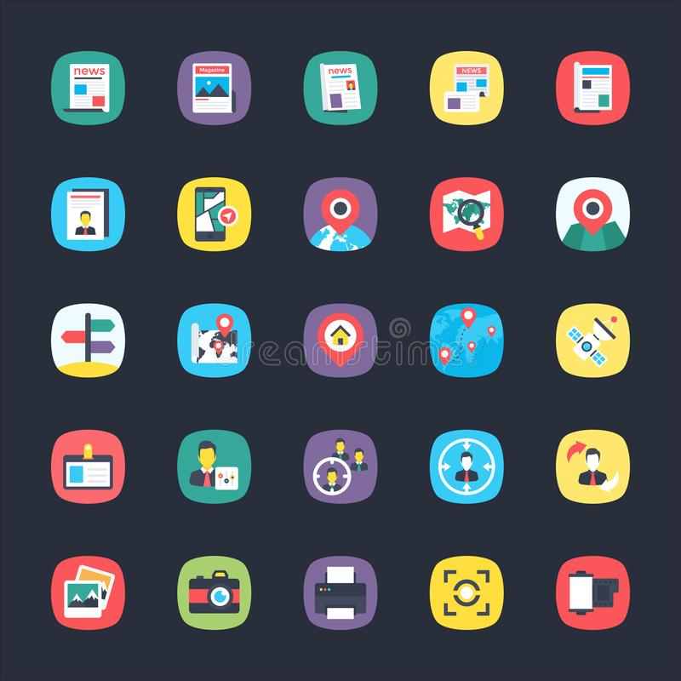

Number of Apps & its Category based on Type
Each category of free and paid types are shown here with number of apps ( blue-free type and orange-paid type). It can be easily seen that there are lot more free apps as compared to the paid apps.

Slide 19
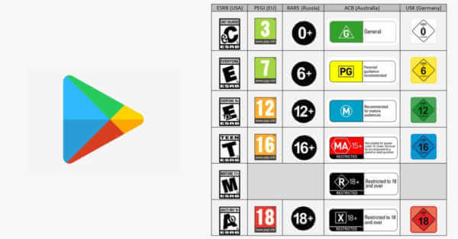
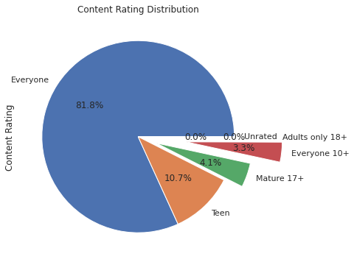
Based on Content Rating
e
Everyone have greater portion in content rating Highest Rating Done by Everyone Then Teen Then 17+ Mature And 10+ Everyone Have almost Same Contribution and No Rating Done by Adults And unrated

Slide 20

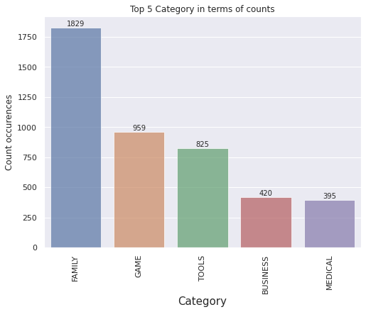




Top 5 Based on Category
This bar graph is showing the analysis of top five category in terms of apps count. We observe that the category 'FAMILY' has the highest number of count, i.e, 1829.

Slide 21

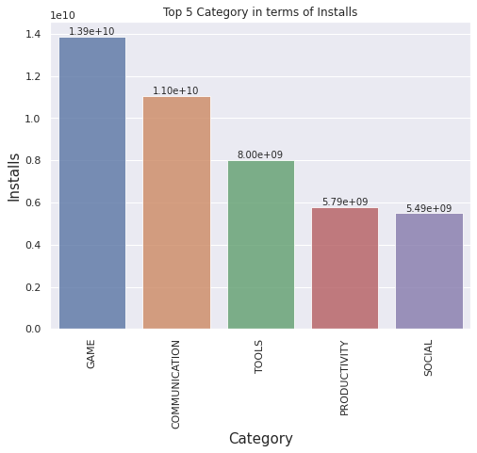


Top 5 category in terms of installs.
This bar graph shows the top five category in terms of installs. The category 'GAME' has the highest number of installs.

Slide 22

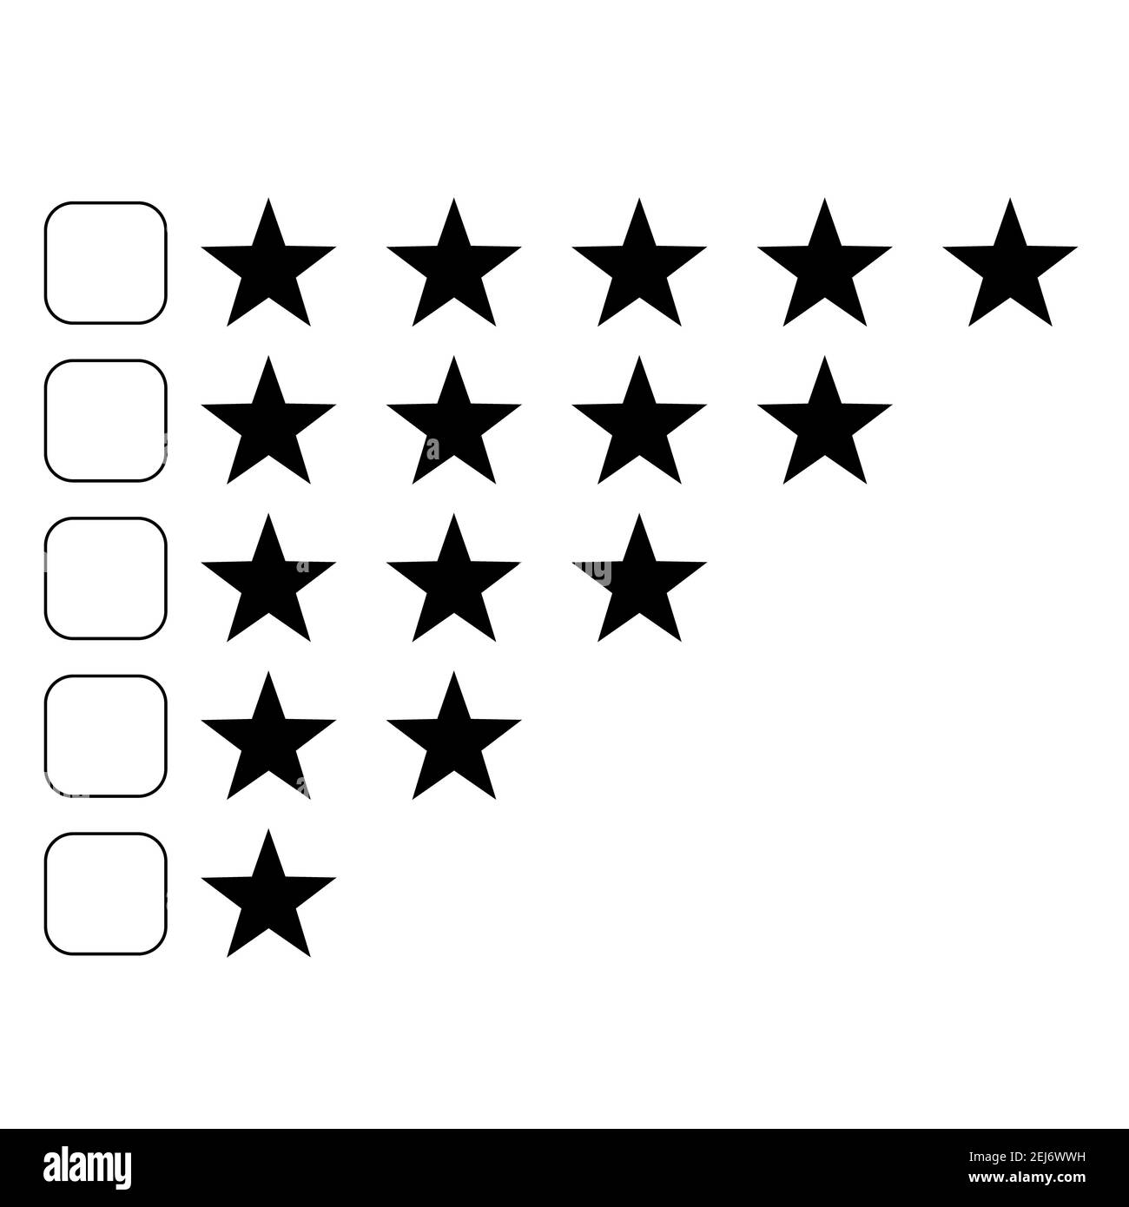
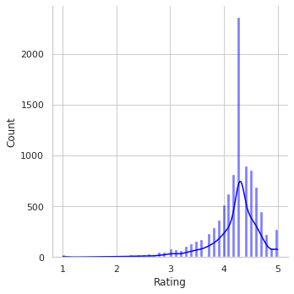

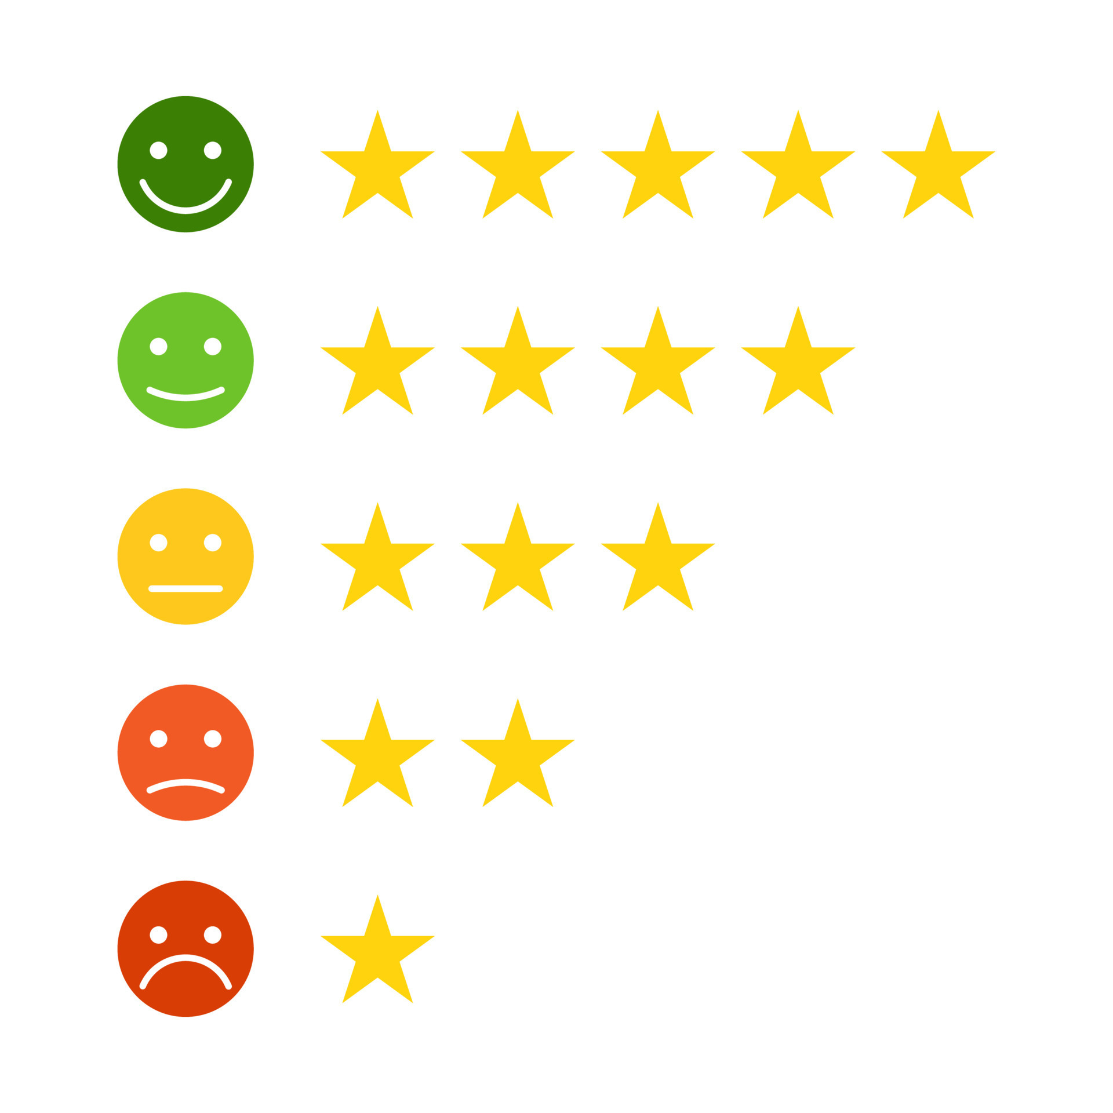
Based on Rating
Highest Number of Rating is of 4.5

Slide 23
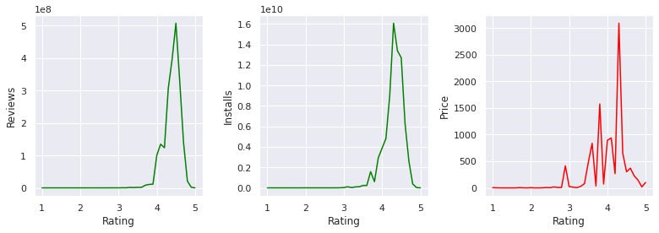
Rating
In analysis of rating pattern most of the app has rating between 4.0 to 4.5 w.r.t Reviews,Installs,Price

Slide 24

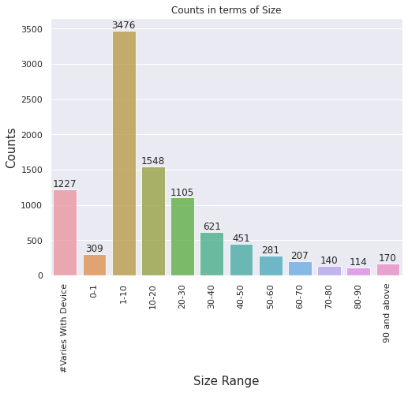
Based on Size Range
Most of the app has size between 1-10 & the fact is the smaller the size the higher the installation

Slide 25
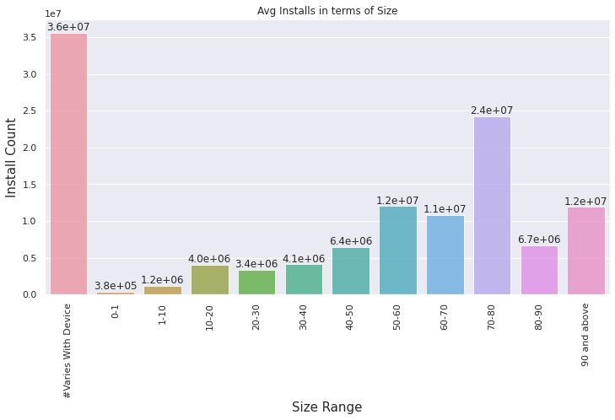
Average Installs in term of size
Average installs is above 3.5 Count and Size Varies from Device

Slide 26


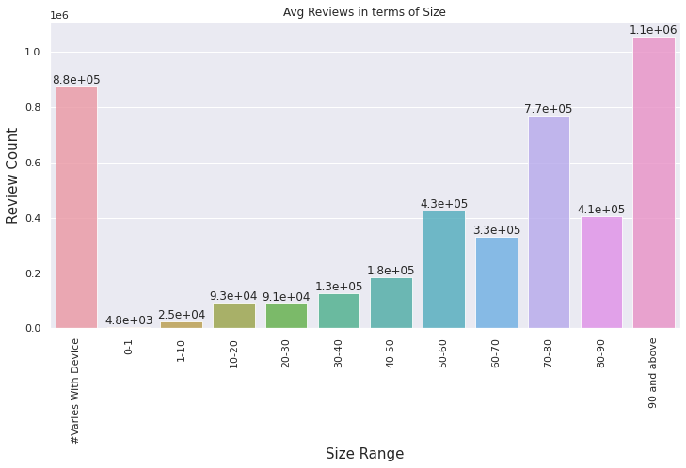
Average Review in term of Size
Average size of an app based on Review is 90 and Above

Slide 27

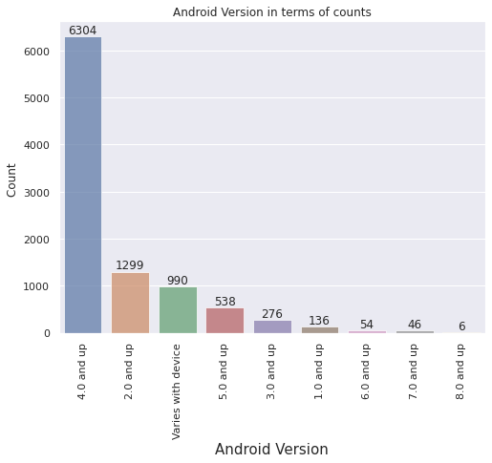

Based on Android Version
In analysis of android version then most of the apps are for version of 4.0 and up

Slide 28

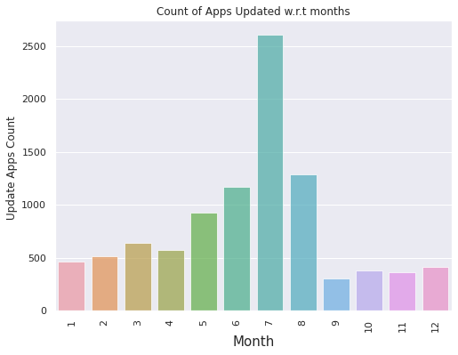

Based On Last Update
If we consider app update month then most of the app update in july

Slide 29

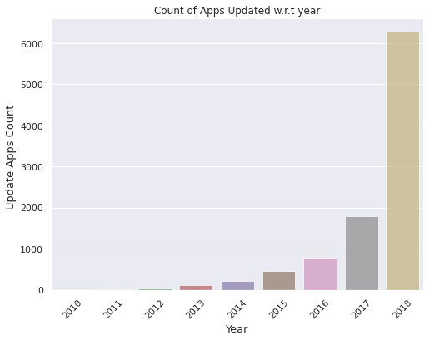

Updates With Years
In analysis of app update year wise then updation of app increasing year on year basis . highest updated in 2018

Slide 30

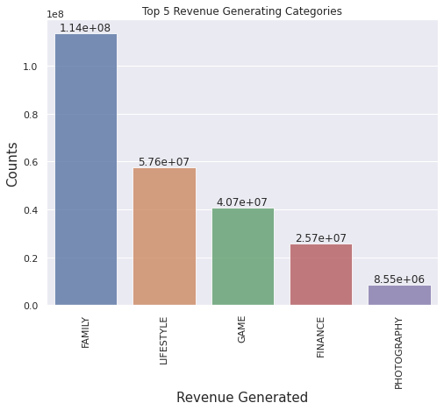

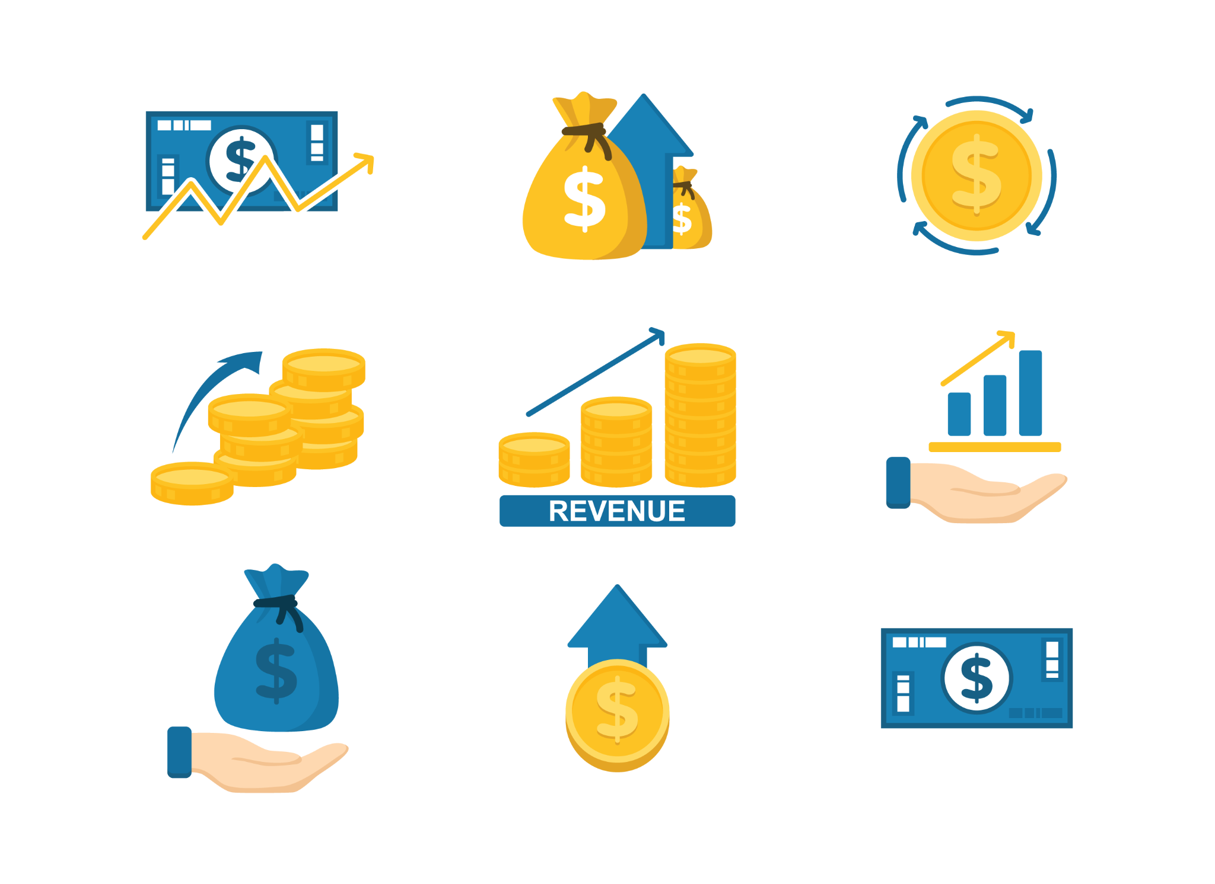
Top 5 Revenue Categories
If we analyse the data in terms of revenue then Family category app has highest revenue

Slide 31
Conclusion
In the free apps 64.1 % apps has positive sentiment followed by 22.4 % and 13.6 % for Negative and Neutral sentiment respectively
In the paid apps 78.1 % apps has positive sentiment followed by 15.1 % and 6.7 % for Negative and Neutral sentiment respectively
From the Sentiment , review graph we can see that no of installs 1000000 and 10000000 has highest review with positive sentiments
Installs and review has a positive correlation
total 92.2 % apps are free and 7.8 % apps are paid in play store data
Family app category contains highest free and paid apps
with content rating analysis 81.8 % apps are of Everyone content rating
In analysis of top Five category in terms of apps count. Family has highest count i.e. 1829 apps and lowest Medical 395
In analysis of top Five category in terms of Installs. Game has highest installs and lowest is social
In analysis of rating pattern most of the app has rating between 4-4.5
In analysis of app size pattern most of the app has size between 1-10
In analysis of android version then most of the apps are for 4.0 and up
If we consider app update month then most of the app update in july
In analysis of app update year wise then updation of app increasing year on year basis . highest updated in 2018
If we analyse the data in terms of revenue then Family category app has highest revenue

Slide 32


